Slide 1
Introduction to Reaction Kinetics: 437/537 (2022)
Material from Reaction & Enzyme Kinetics, Sauro
(Adapted by JL Hellerstein, 1/2023)

Slide 2
What is Chemical Kinetics
Studies the rate at which a chemical process occurs and what factors influence the rate.
Hardcore kineticists also study the reaction mechanism (i.e exactly how the reaction occurs).

Slide 3
Assumptions
In the following slides we will assume the following:
1. The reaction systems are spatially homogeneous at every moment of time evolution.
2. The underlying reaction rates are described by the mass action law (to be described).
3. Large number of molecules. Can approximate with deterministic equations. (There are approximately 2,000,000 to 3,000,000 molecules of ATP in an E. coli cell.)

Slide 4

Deterministic Models
Deterministic kinetic modeling of biochemical reactions
Basic quantities:
Concentration S : number of molecules per unit of volume
Reaction rate v : concentration change per unit time
The reaction rate v at a point in space at time t can be expressed as a unique function of the concentrations of all substances at that point at time t:
Simplifying assumptions:
- spatial homogeneity (well-stirred)
- time independent systems (not directly dependent on time)

Slide 5
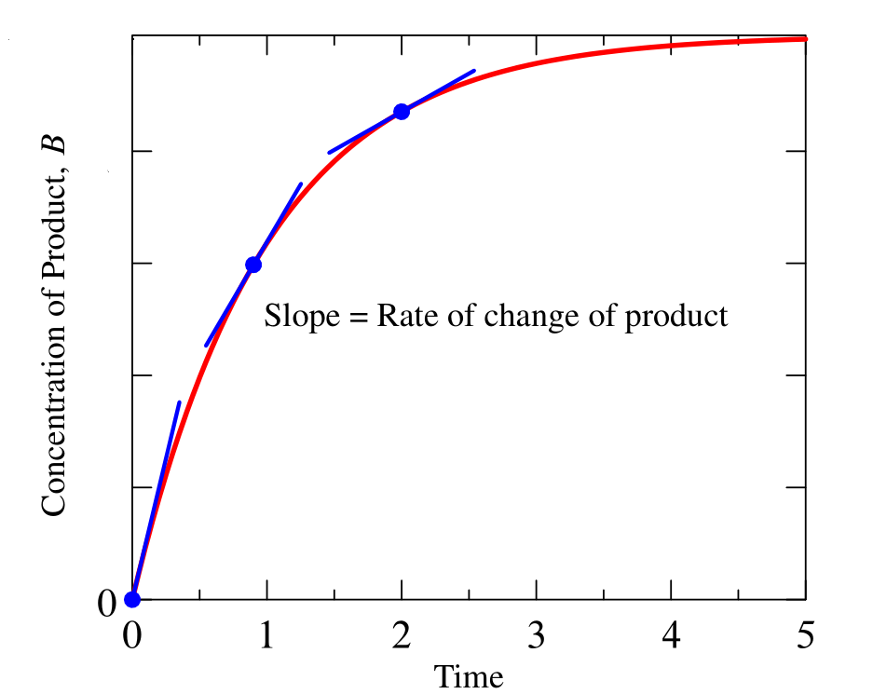

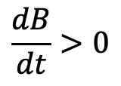
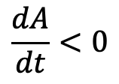
Reaction Progress
$$\frac{dA}{dt}<0$$
$$\frac{dB}{dt}>0$$
Rate of change of a concentration depends on sthoichiometry.

Slide 6

Stoichiometric Coefficients
Example:
The stoichiometric coefficient of A must take into account the fact that A appears both as a reactant and a product. The overall stoichiometric coefficient of A is therefore 1 - 2 which gives -1.
The stoichiometric coefficient for B is -1 and for C is +1

Slide 7


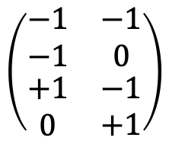
Stoichiometry Matrix
Rows are species.
Columns are reactions.
Entry value: stoichiometry of product – reaction.
J1
J2
$$J1: 2A+B→A+C$$
A
$$\left(\begin{matrix}\begin{matrix}−1 \\ −1\end{matrix} & \begin{matrix}−1 \\ 0\end{matrix} \\ \begin{matrix}+1 \\ 0\end{matrix} & \begin{matrix}−1 \\ +1\end{matrix}\end{matrix}\right)$$
B
$$J2: A+C→D$$
C
D

Slide 8
Mass-Action Kinetics
Chemical reactions that involve no reaction intermediates are called elementary reactions.
Such reactions often have simple kinetic properties and empirical studies have shown that the rate of reaction is often proportional to the product of the molar concentration of the reactants raised to the power given by the stoichiometric amount.

Slide 9


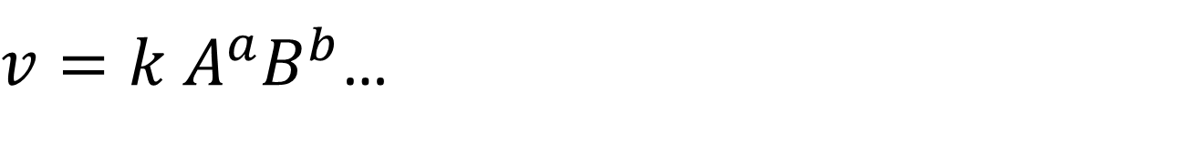
Mass-Action Kinetics
Reactions often have simple kinetics that proportional to the product of the molar concentration of the reactants raised to the power given by the stoichiometric amount.
For a simple elementary monomolecular reaction such as:

Slide 10
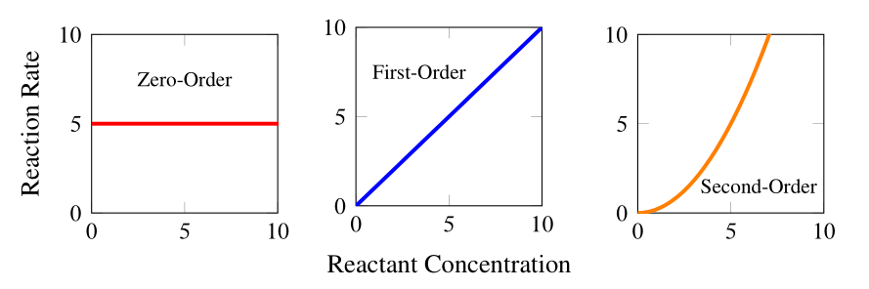



Order of the Reaction
The order of the reaction for a given species is the power that a species is raised. In other words, the order of a reversible reaction for an elementary reaction is the stoichiometric amount.
$$v=k$$
$$v=kS$$
$$v=kS_{1}S_{2}$$

Slide 11
Catalysts
Key concepts:
Catalysts, such as enzymes, speed up the forward and reverse rates equally.
They do not change the equilibrium constant.

Slide 12
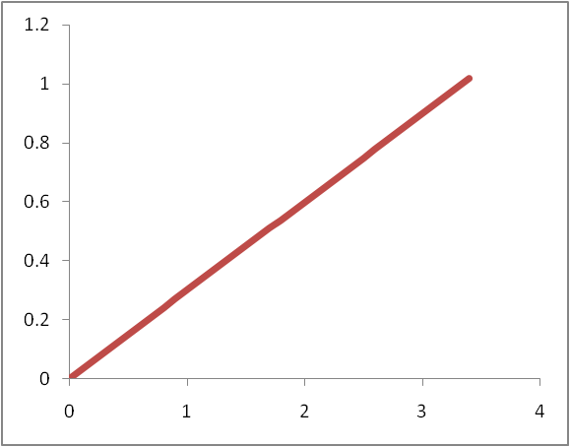
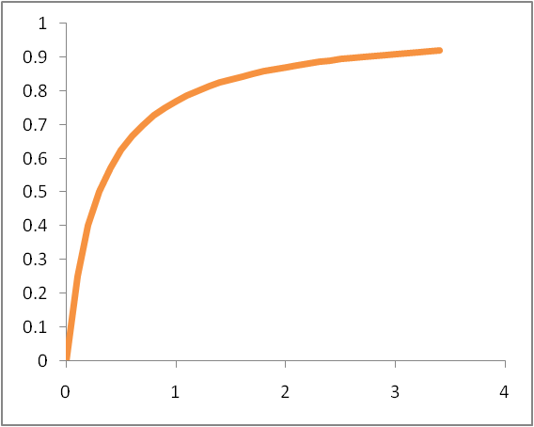
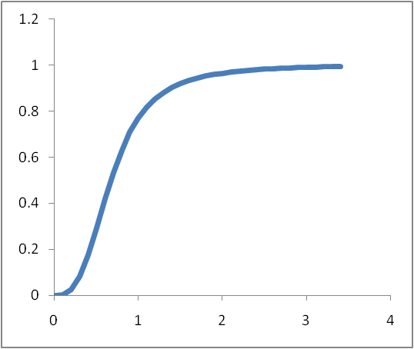
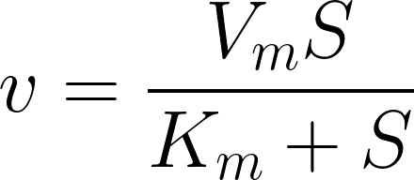
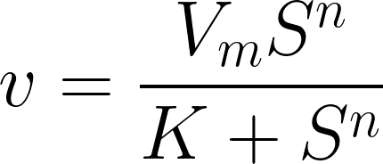

Kinetics with Catalysts
1st order Mass action
Michaelis-Menten
Hill
No catalyst
Catalyst
Catalyst with cooperativity

Slide 13
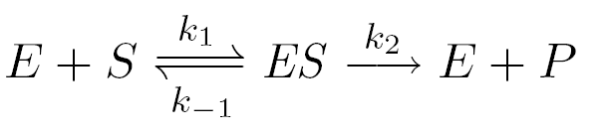
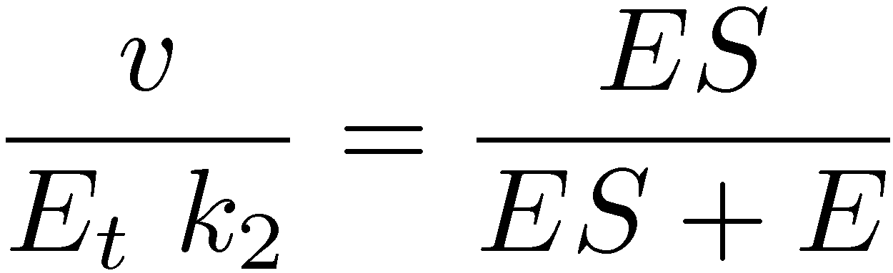
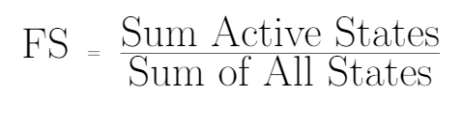
Fractional Saturation
Yields:
This shows that the rate is proportional to the fraction of total enzyme that is bound to substrate.
This expression gives us the fractional saturation.

Slide 14
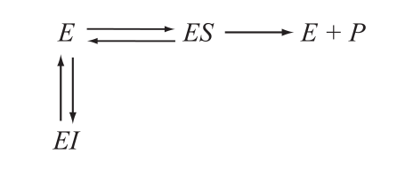
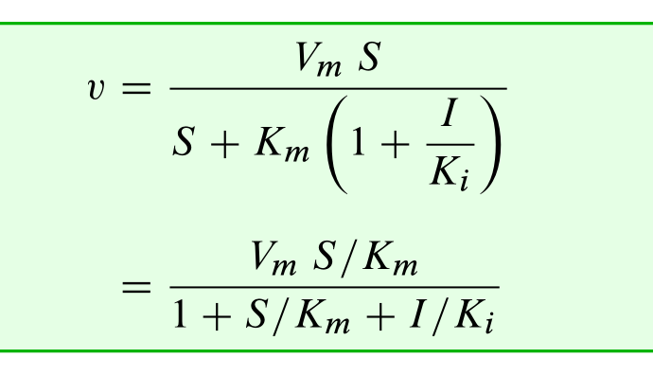
Competitive Inhibitors:
The classic inhibitor is
the competitive inhibitor

Slide 15
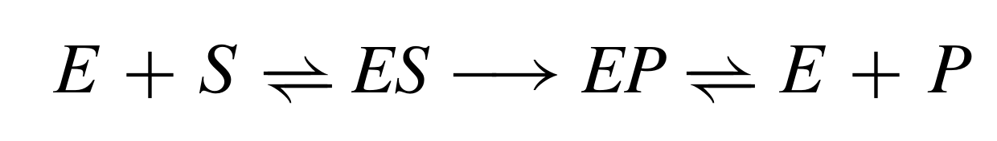
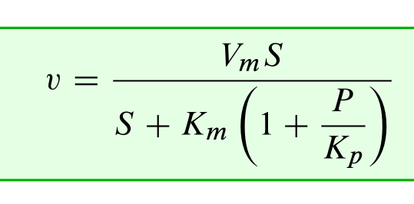
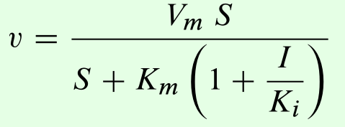
Product Inhibition:
There is a special form of competitive inhibition called
Product Inhibition

Slide 16
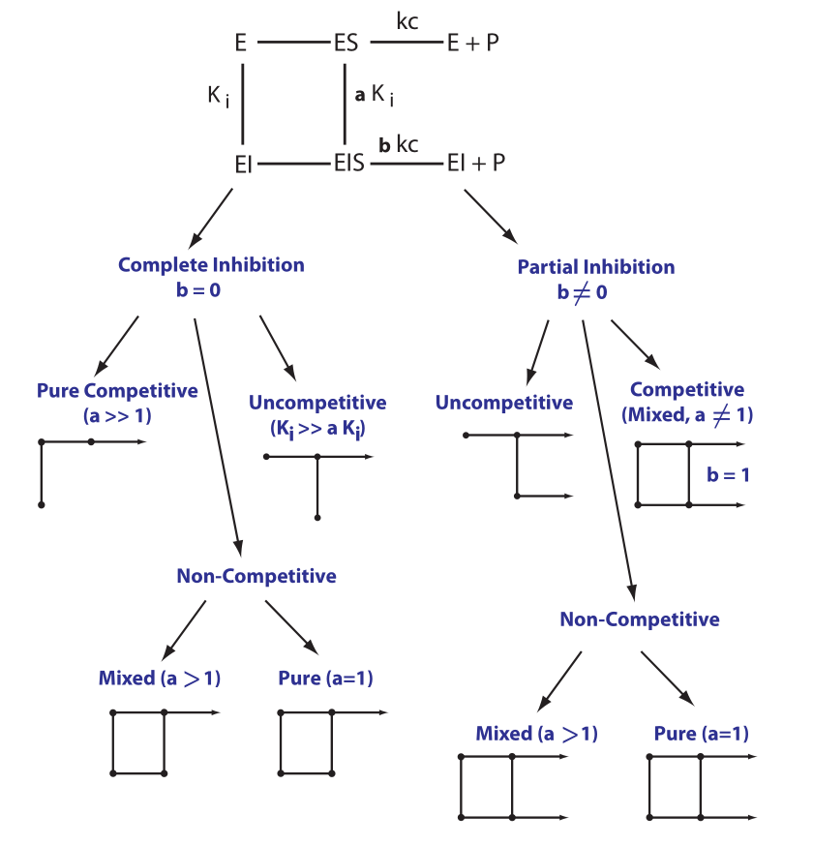
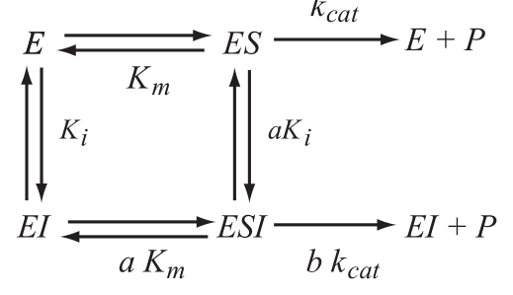
Inhibitors: Reversible
The world of inhibitor mechanisms is complicated as there are many ways in which inhibitors can act.

Slide 17
Competitive Inhibitors:
The classic inhibitor is
the competitive inhibitor
The earliest "antibiotics", the Sulfa drugs were
competitive inhibitors of dihydropteroate synthase.
Used extensively in WWII

